Slide 1
NEURO-FUZZY BASED IoT ASSISTED POWER MONITORING SYSTEM FOR SMART GRID
BATCH-VIII
BATCH MEMBERS :
N.SABARI VIGNESH - 922318105039
R.SATHISH KUMAR - 922318105043
M.DHARUN - 922318105301
S.KARTHICK - 922318105501
PROJECT GUIDE
Mrs. S. Kirubadevi, AP/EEE

Slide 2
INTRODUCTION
The IoT is commonly utilized for intelligent energy control.
IoT sensors are installed in various stages of smart grid to track and manage network statistics for safe and efficient power delivery.
The challenge in the integration of IoT Smart Grid must be over come for the network to the function efficiently.
In order to over come the challenges an IoT based smart grid energy monitoring system depending on neuro fuzzy is proposed.

Slide 3
OBJECTIVE
To control the power flow, load requirement and improve the power quality in the system using Anfis controller and the power electronic devices embedded in the power system.
To provide battery backup and add fuzzy logic controller to control the battery operations like charging and discharging.
To use IoT sensor for reading the necessary parameters like voltage, current, real power, reactive power and transmit to analytics platform.

Slide 4
EXISTING SYSTEM
In Existing system the smart grid consist of wind and solar power plant is
controlled by fuzzy logic controller
The control of power flow in the system is not so much efficient.
The system mainly operates based on the reference value from load side and
control the power flow to meet the load demand.
There is no battery backup and monitoring system.

Slide 5
PROPOSED SYSTEM
In the proposed system neuro fuzzy logic based algorithm is implemented for
power management and IoT sensors are used for monitoring solar and wind
system with grid parallel power system.
To control the power, an adaptive neuro-fuzzy inference system (ANFIS) is
used in the smart grid and the battery backup is provided.
The Anfis controller considers the input power from the renewable energy
sources and the output power required by the consumers and then it allow
the power to meet the load demand.

Slide 6
BLOCK DIAGRAM
Solar Radiation
PV Module
FixedDC
DC/DC Converter
Monitoring
Temperature
ANFIS Controller
Load
Wind Turbine
Wind
Speed
Fixed DC
AC/DC Converter
DC/AC Converter
Mechanical Output
Turbine Torque
~
Grid
Asynchronous Induction Generator
Air Condition
Battery
DC Bus
Fig 1.1 Block diagram

Slide 7
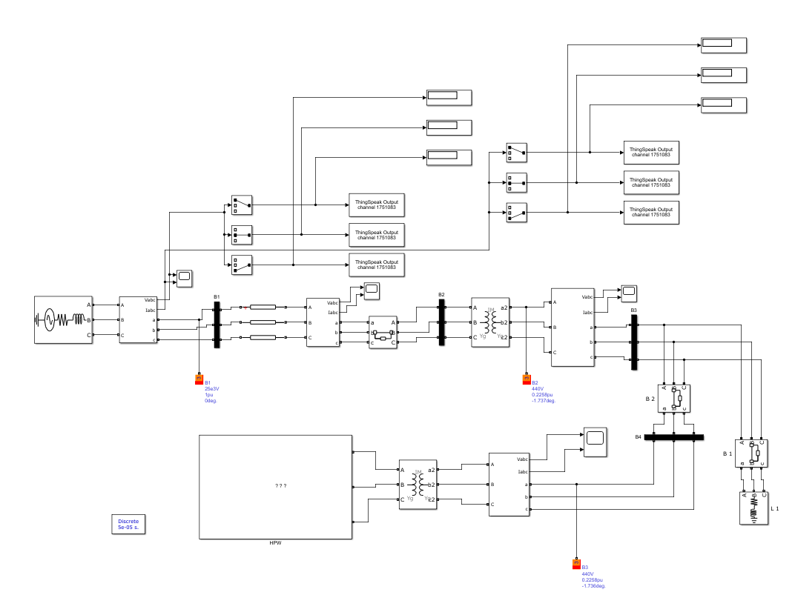
OVERALL IMPLEMENTATION
Fig.1.2 Overall implementation

Slide 8
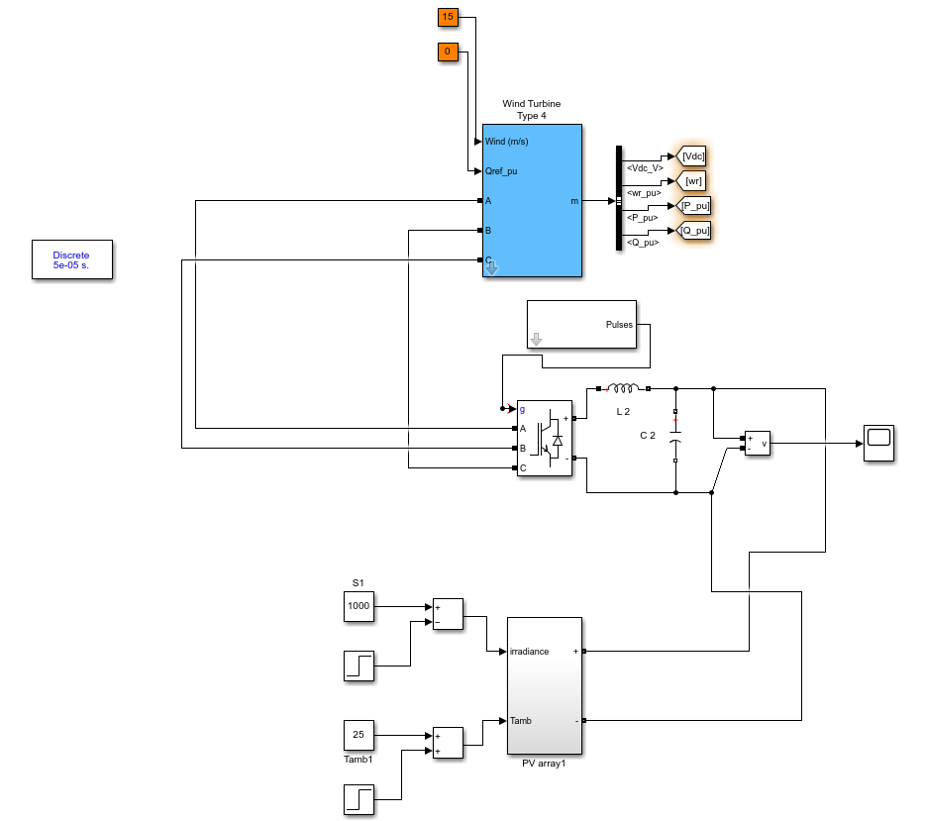
IMPLEMENTATION OF MICRO GRID
Fig 1.3 Implementation of micro grid

Slide 9
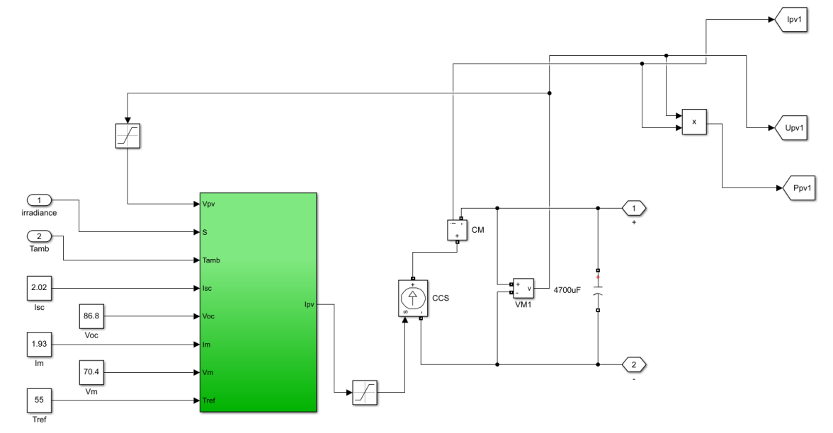
SOLAR PV SYSTEM
Fig 1.4 Implementation of solar PV system

Slide 10
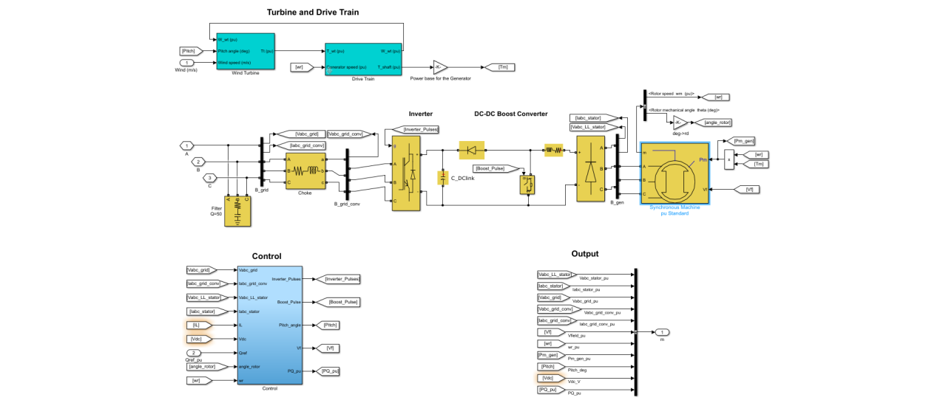
WIND TURBINE
Fig 1.5 Implementation of wind turbine

Slide 11
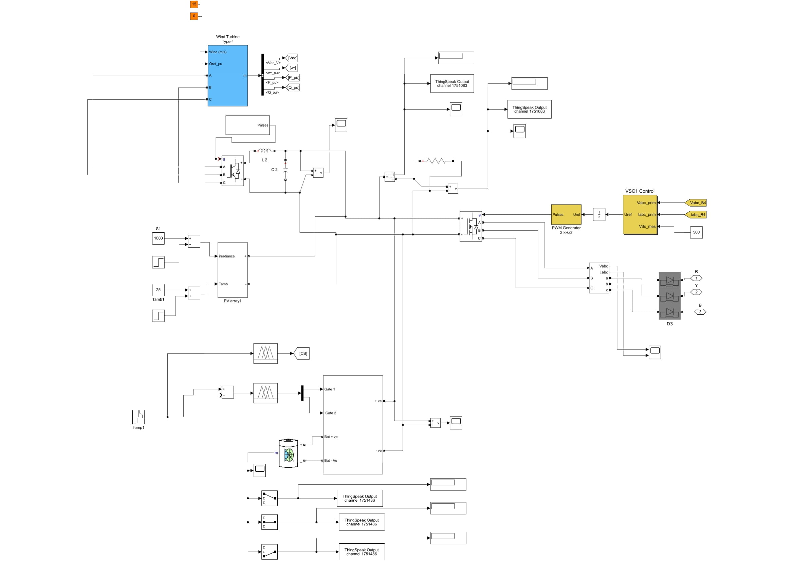
IMPLEMENTATION OF MICRO GRID WITH ANFIS AND BATTERY BACKUP
Fig.1.6 Implementation of micro grid with anfis and battery backup

Slide 12
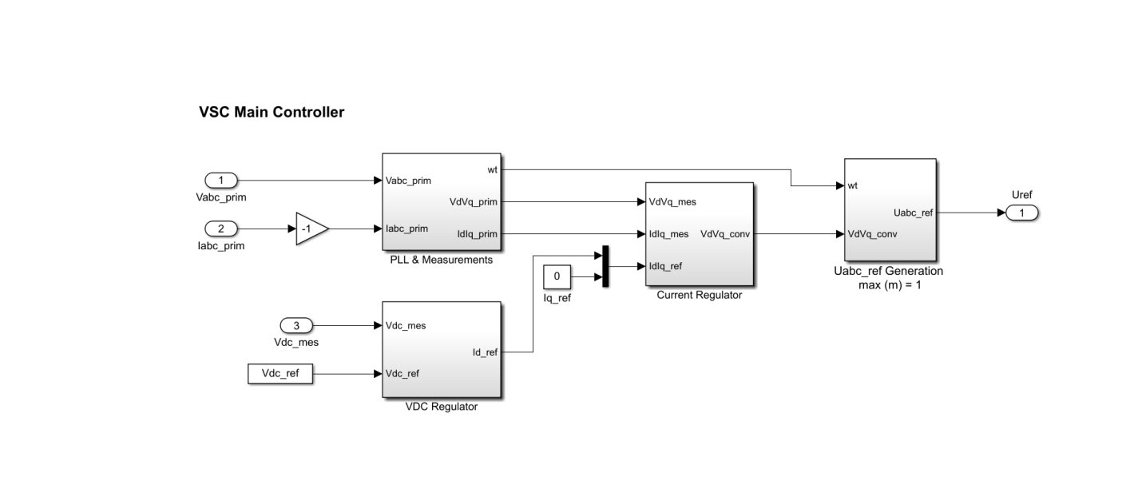
VSC MAIN CONTROLLER
Fig.1.7 VSC main controller

Slide 13
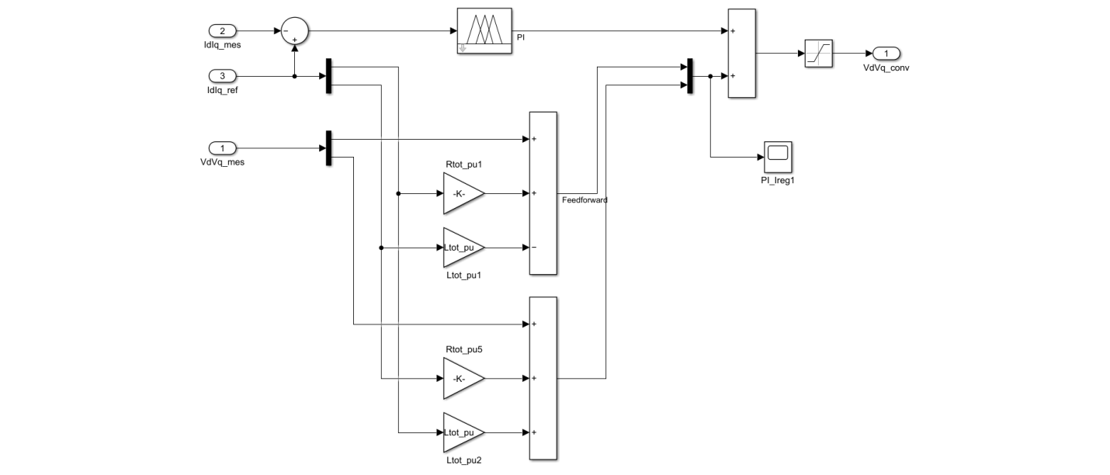
IMPLEMENTATION OF ADAPTIVE NEURO FUZZY INFERENCE SYSTEM
Fig.1.8 Implementation of adaptive neuro fuzzy inference system

Slide 14
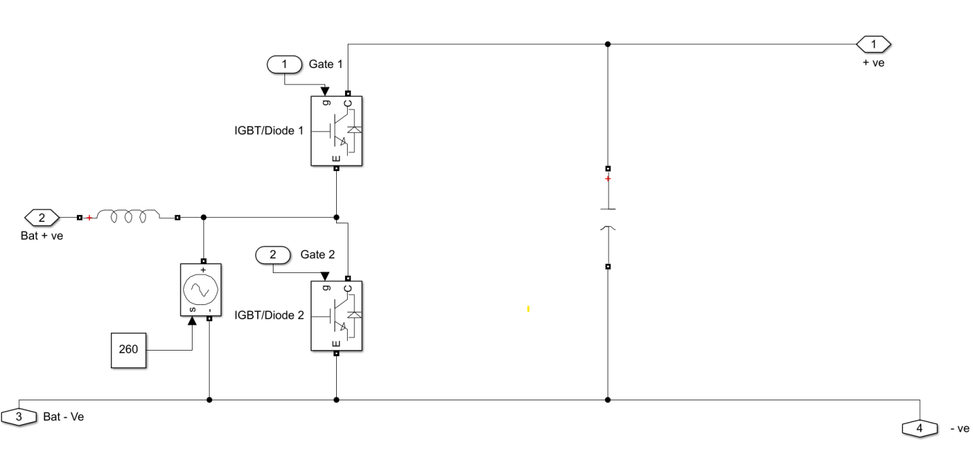
SUBSYSTEM FOR BATTERY CONNECTION
Fig.1.9 Subsystem for battery connection

Slide 15
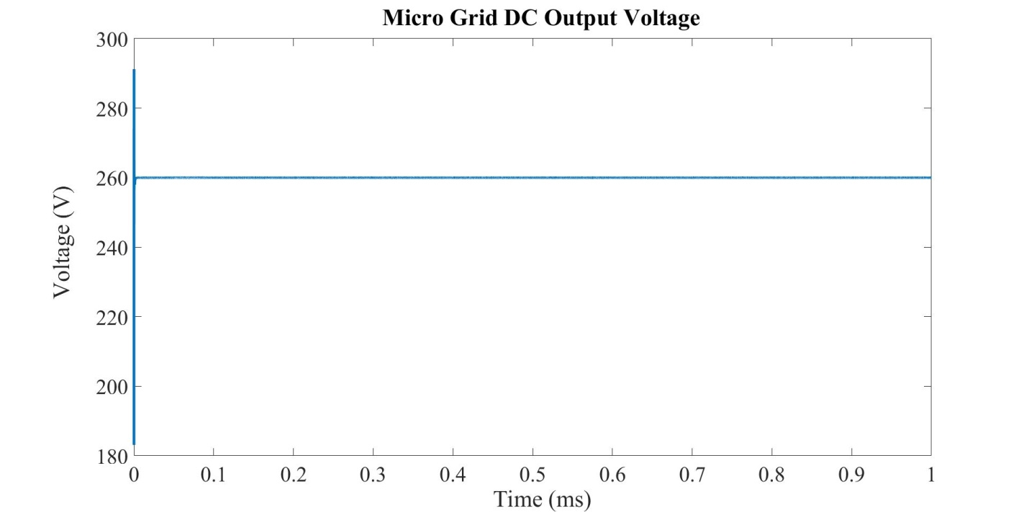
MICRO GRID DC OUTPUT VOLTAGE
Fig.1.10 Micro grid dc output voltage

Slide 16
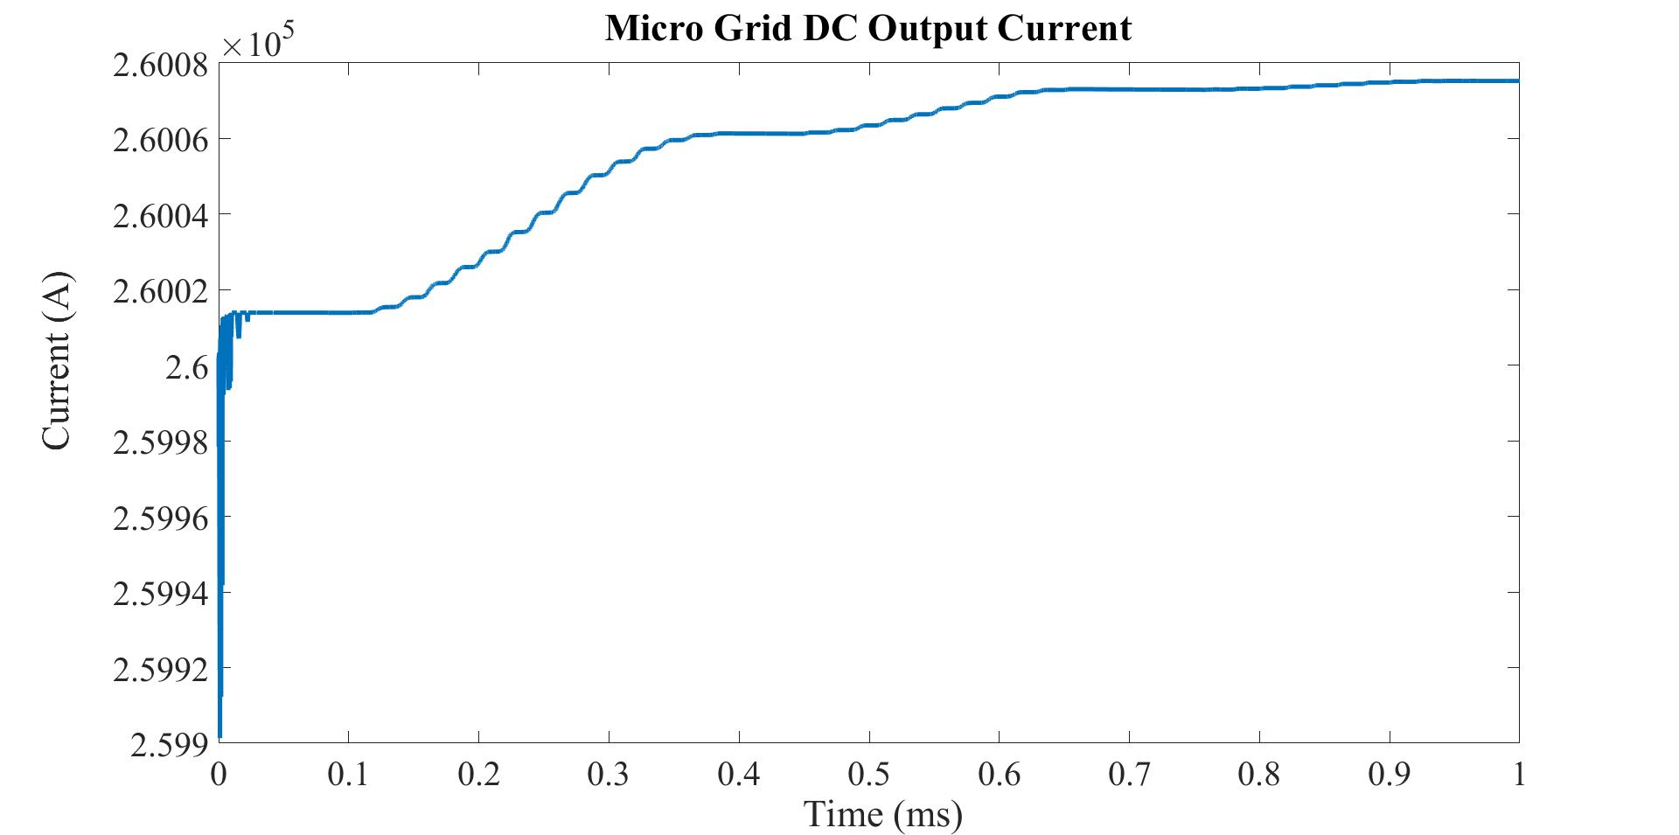
MICRO GRID DC OUTPUT CURRENT
Fig.1.11 Micro grid dc output current

Slide 17
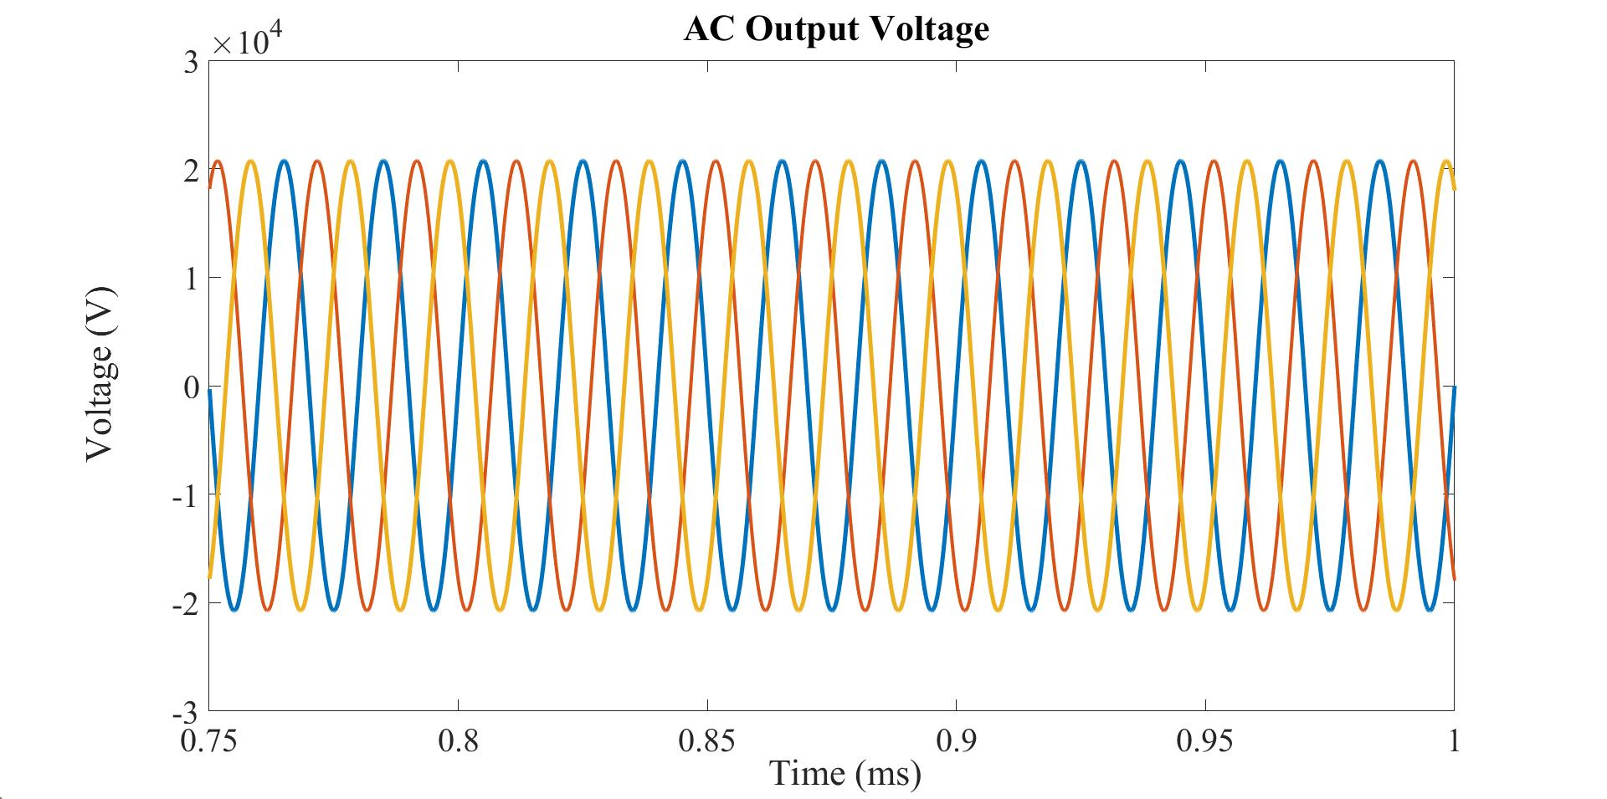
AC OUTPUT VOLTAGE
Fig.1.12 AC output voltage

Slide 18
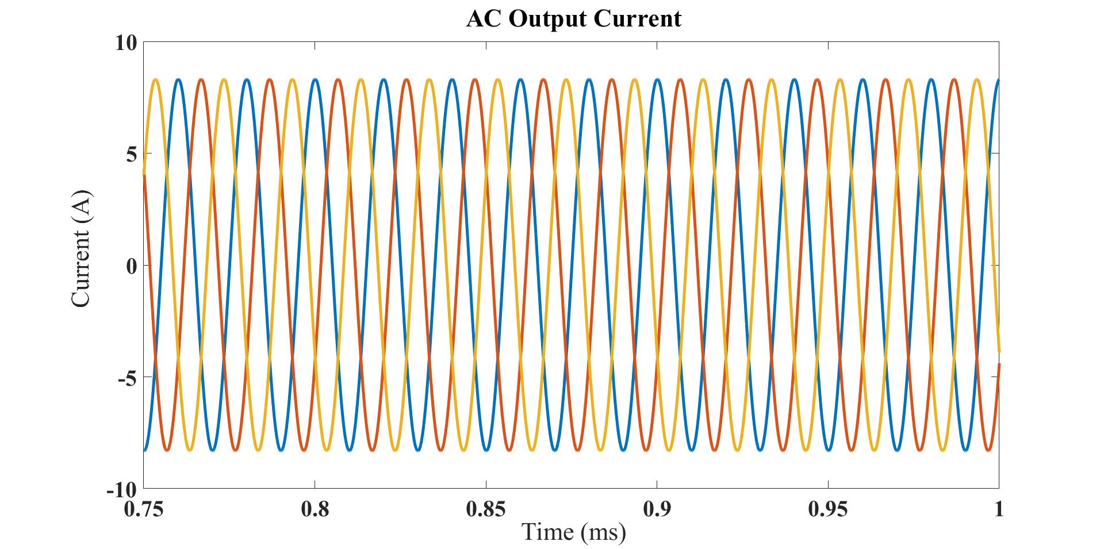
AC OUTPUT CURRENT
Fig.1.13 AC output current

Slide 19
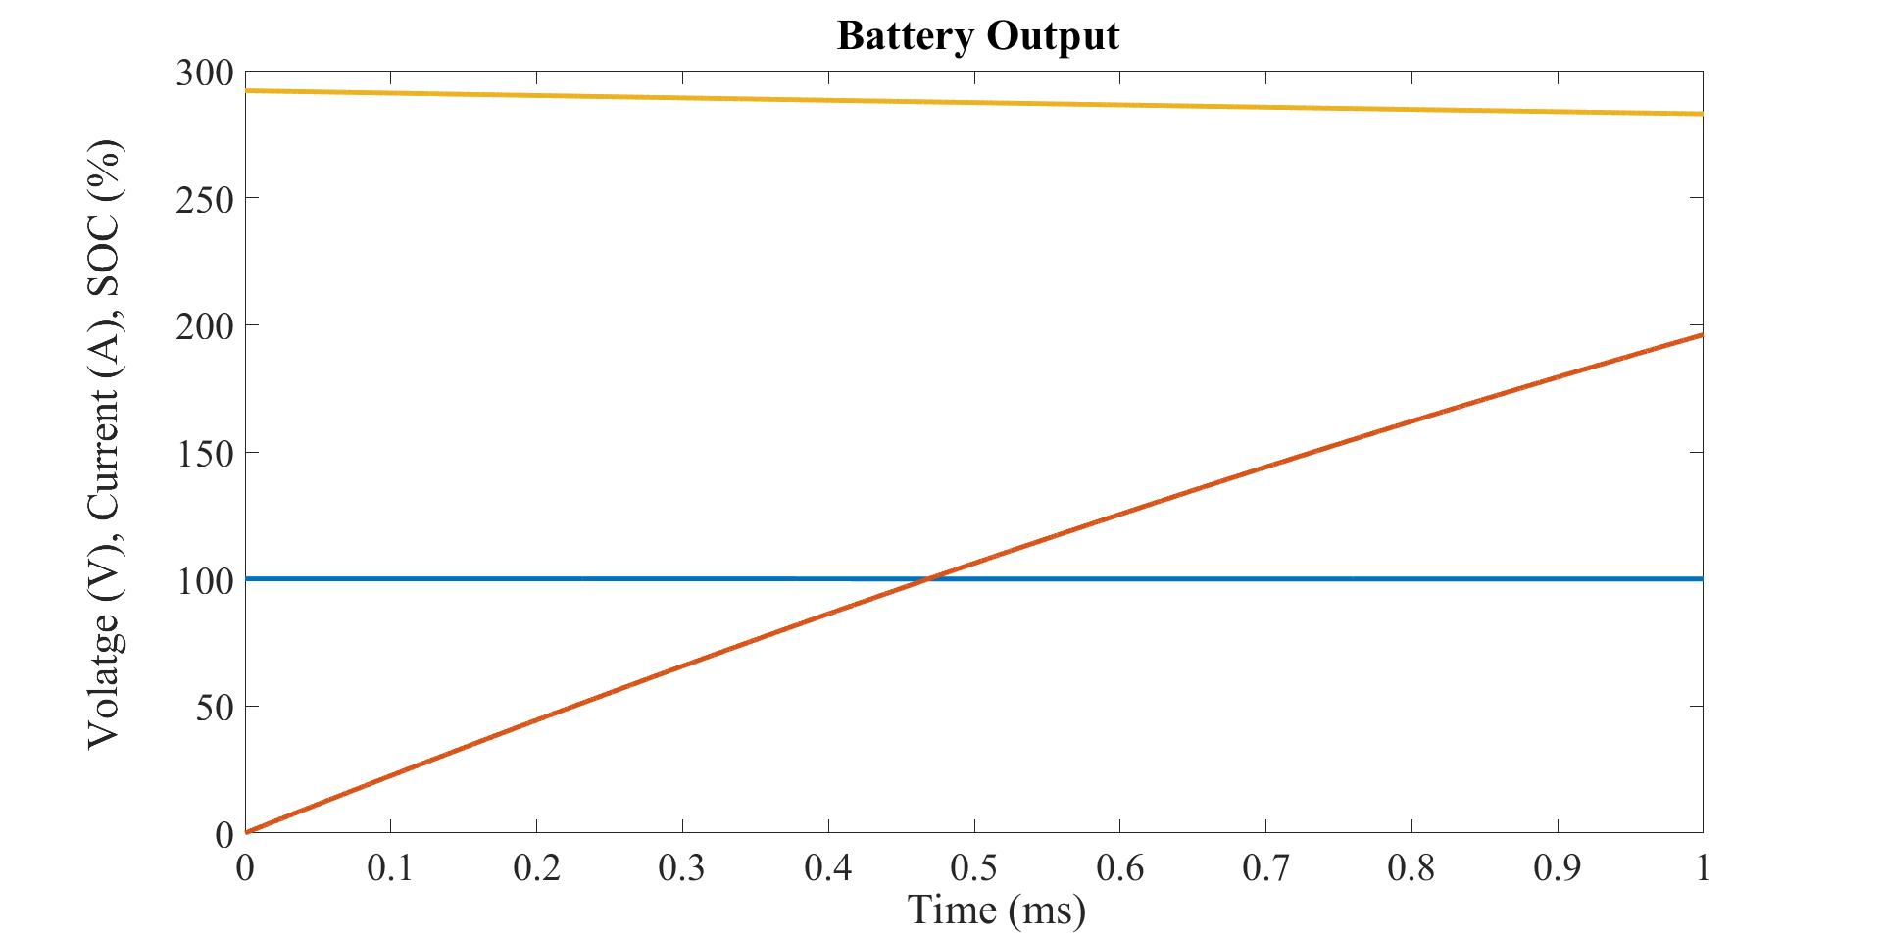
BATTERY OUTPUT
Fig.1.14 Battery output

Slide 20
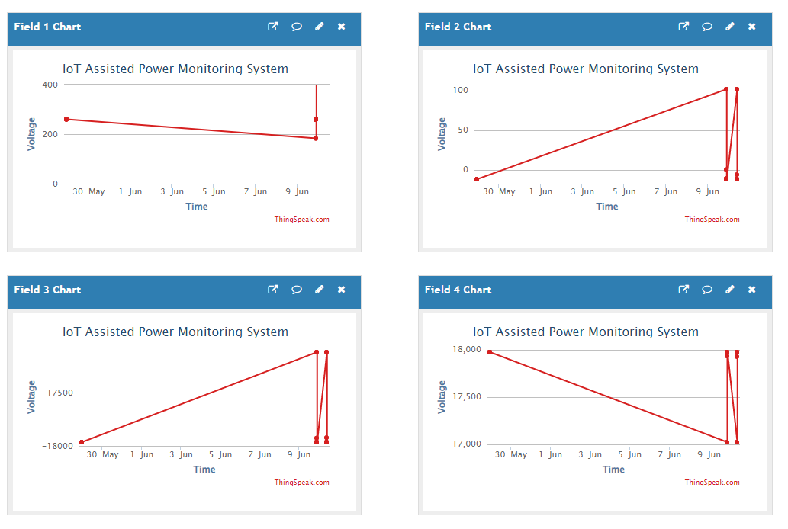
Data monitoring graph
Fig.1.15 Data monitoring graph

Slide 21
RELATIONSHIP GRAPH OF AC VOLTAGE AND CURRENT
Fig.1.16 Relationship graph of ac voltage and current

Slide 22
CONCLUSION
The implementation of a Neuro-Fuzzy-based IoT-assisted power monitoring setup is described in this project.
In the smart grid, a controller called ANFIS is used to control hybrid solar and wind power plants and battery is provided for backup purpose.
The ANFIS based power management improved the power outcome of the wind and solar power plants to a great extent.
The implemented IoT based Neuro-Fuzzy concept for power monitoring using Simulink software and the parameters like power, current and voltage of the load are taken into consideration.
The proposed design would help in the production of low-cost power monitoring and the sensing devices that are easy to incorporate into user environments.

Slide 23
REFERENCES
[1] F. Al-Turjman and M. Abujubbeh, ‘‘IoT-enabled smart grid via SM: An overview,’’ Future Gener. Comput. Syst., vol. 96, pp. 579–590, Jul. 2019.
[2] M. Babar, M. U. Tariq, and M. A. Jan, ‘‘Secure and resilient demand side management engine using machine learning for IoT-enabled smart grid,’’ Sustain. Cities Soc., vol. 62, Nov. 2020, Art. no. 102370.
[3] Z. Wang, Y. Liu, Z. Ma, X. Liu, and J. Ma, ‘‘LiPSG: Lightweight privacy preserving Q- learning-based energy management for the IoT-enabled smart grid,’’ IEEE Internet Things J., vol. 7, no. 5, pp. 3935–3947, May 2020.
[4] A. H. Bagdadee, M. Z. Hoque, and L. Zhang, ‘‘IoT based wireless sensor network for power quality control in smart grid,’’ Proc. Comput. Sci., vol. 167, pp. 1148–1160, Jan. 2020

Slide 24
THANK YOU...

